Slide 1
EGB1122 – PYTHON PROGRAMMING
PROJECT REVIEW-1
Department of Electronics and Communication Engineering
Academic Year: 2024 – 2025 (Even Semester)
Register Number : 2403811710622113
Name : SUJITHA M
Year : I
Semester : II
Section : L
Date : 30 / 04 / 2025

Slide 2
PATIENT MONITORING SYSTEM

Slide 3
Abstract
• Introduction.
• Python programming Concepts used.
• Proposed Architecture.
• Proposed Architecture - Description.
• List Of Modules.
• Modules - Description .

Slide 4
Introduction
A Patient Monitoring System is a medical technology solution designed to track and monitor the health of patients in real time. This system can be used in hospitals, clinics, or even at home to continuously observe vital signs such as heart rate, blood pressure, body temperature, and oxygen saturation levels.

Slide 5
Python Programming - Concepts Used
In this Python project, we develop an automated system that can simulate the monitoring of a patient's health metrics and alert the relevant medical staff when certain thresholds are breached. It uses Python libraries to handle data collection, processing, and visualization, making it both an efficient and scalable solution.

Slide 6
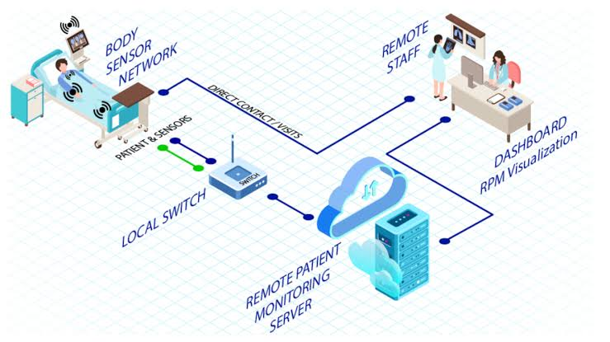
Proposed Architecture

Slide 7
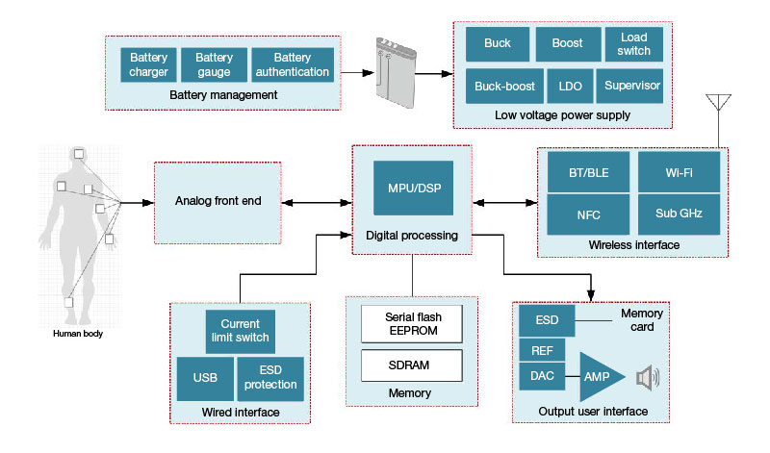
BLOCK DIAGRAM

Slide 8
Proposed Architecture - Description
A typical proposed architecture for a patient monitoring system involves sensors collecting vital signs, a data acquisition layer like a smartphone app, a transmission layer (5G or other network), a database for storage and processing, and potentially a machine learning or AI component for analysis and alerts.

Slide 9
List of Modules
Modules for Patient Monitors
--> Multiparameter Module.
--> Capnography.
--> Pulse Oximetry.
--> Electrocardiography.
--> Non-Invasive Blood Pressure.
--> Body Temperature.
--> Invasive Blood Pressure.

Slide 10
Description of Modules
Patient monitoring system modules are crucial components that track and display a patient's physiological parameters in real-time, encompassing vital signs like heart rate, blood pressure, and oxygen saturation, and can be part of centralized or portable monitoring systems.
Examples :
• ECG (Electrocardiogram) sensors: Measure heart activity.
• Respiration sensors: Measure breathing rate.

Slide 11
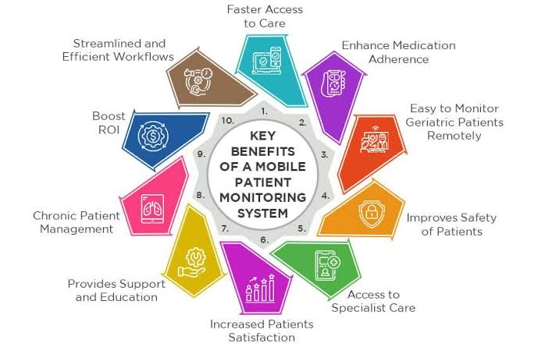
Benefits :

Slide 12
CODING
import random
import time
def monitor_patient():
print("Patient Monitoring System (Ctrl+C to stop)")
print("----------------------------------------")
while True:
# Simulate vital signs
heart_rate = random.randint(60, 100)
oxygen_level = random.randint(90, 100)
temperature = round(random.uniform(36.0, 37.5), 1)
# Display vitals
print(f"\nHeart Rate: {heart_rate} bpm | Oxygen: {oxygen_level}% | Temp: {temperature}°C")

Slide 13
CODNIG
# Check for alerts
if heart_rate < 65:
print("⚠️ ALERT: Low heart rate!")
if heart_rate > 95:
print("⚠️ ALERT: High heart rate!")
if oxygen_level < 94:
print("⚠️ ALERT: Low oxygen level!")
if temperature > 37.2:
print("⚠️ ALERT: Fever detected!")
time.sleep(2) # Check every 2 seconds
try:
monitor_patient()
except KeyboardInterrupt:
print("\nMonitoring stopped

Slide 14
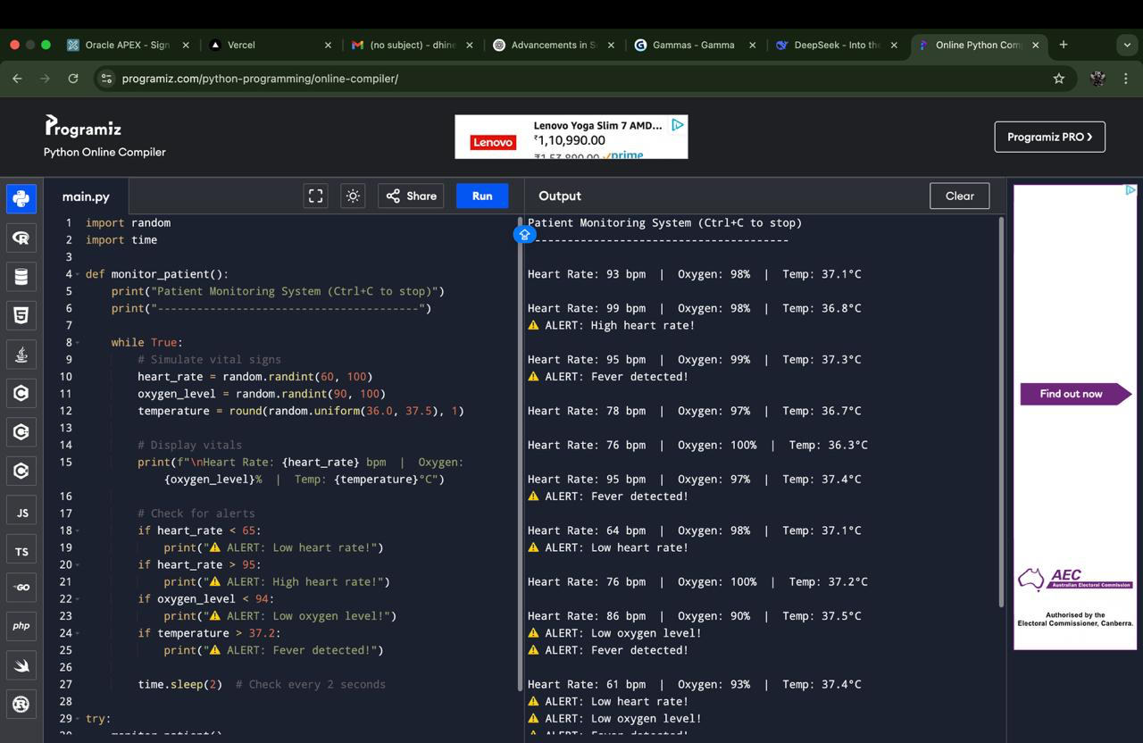
OUTPUT

Slide 15
Thank You
Any queries???

